Slide 1
Candidate Campaign Planning:
How to Make a Campaign Plan

Slide 2
Agenda
Welcome!
What is a Campaign Plan?
Budgeting & Fundraising
Direct Voter Contact
Communications + Networking
Top Takeaways
Additional Resources
Q&A

Slide 3
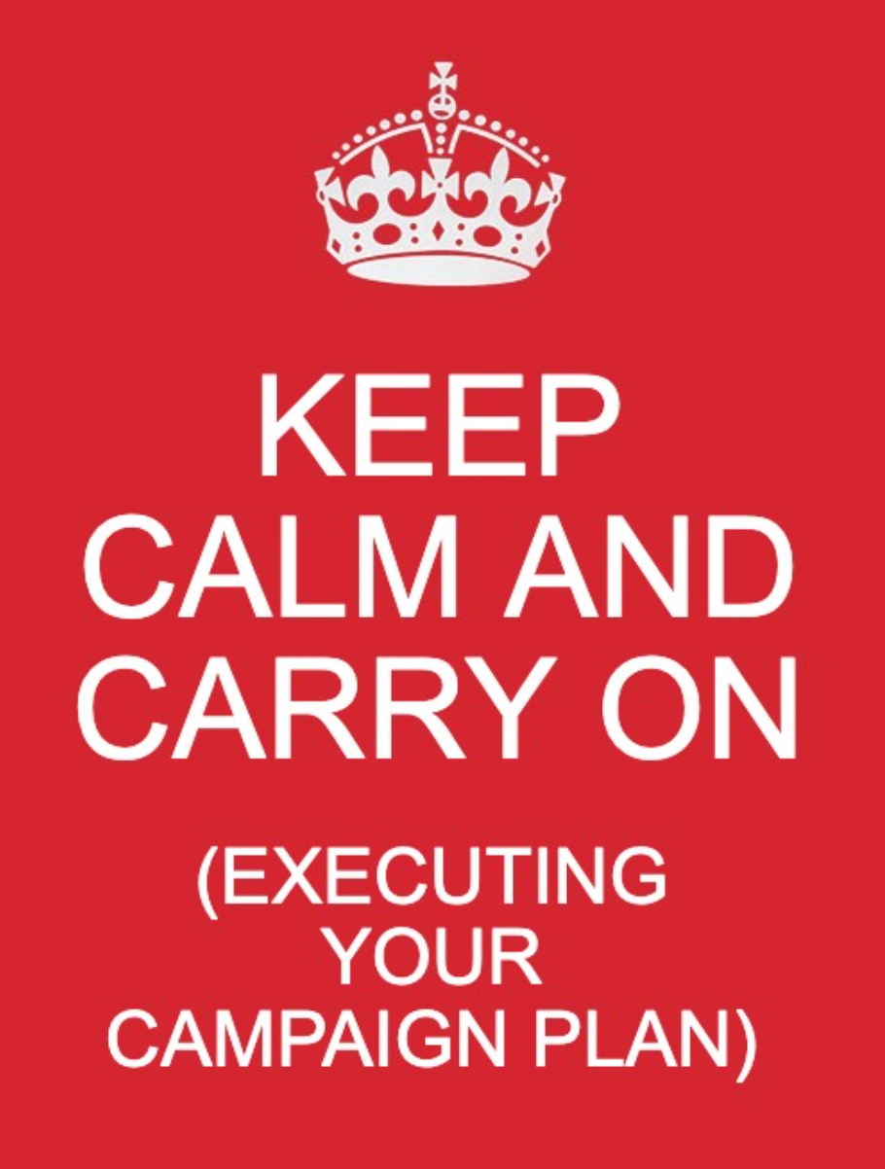
Why Write a Campaign Plan?
What is a Campaign Plan?
Elections come up quick!
Tool to set goals, benchmark progress
A plan helps you manage competing priorities & spend limited resources on tactics to earn votes
Your Blueprint to Victory.
A written document
Specific goals, strategies, & timelines
Ambitious but attainable
Centered on voter contact & delivering your message to your target voters.
Notes:
Running for office can be overwhelming., and you will be juggling a lot of different things especially as it gets closer to the election. Writing a campaign plan allows you to effectively pace your race and yourself. A campaign plan will keep you on track, help you hold yourself accountable, help show you the progress you are making, help you achieve your goals, and ultimately help you win your campaign. A good plan will allow you to use your limited time to greatest effect.
Your Blueprint for Victory
A campaign plan is a written document with specific goals, strategies , timelines and benchmarks that work for your campaign. It is focused on person-to-person voter contact and delivering your message to targeted voters.

Slide 4
SAMPLE CAMPAIGN PLAN
Components of a Good Plan?
Targeting: What does turnout typically look like? How many votes will I likely need to win? Where can I find those votes? (i.e who is likely to vote for me AND who typically votes in these kinds of elections?)
Tactics: How will you reach voters? (i.e phone calls, mail, etc).
Budget: What will you need? What will it cost?
Fundraising Plan: How will you raise $ you need for your race?
Timeline: Working backwards from E-Day, what needs to happen and when for you to meet your goals for voter contact and fundraising.
Total Registered Voters:
Estimated Turnout: %
Votes needed to win:
Voter Contact Goal:
Budget:
_ Mailings(_____ postcards + Postage) $___
Signs (___) $___
---------------------------------------
Total Budget $______
Timeline: Week 1 Voter contact Goal: _____calls Week 1 Fundraising Goal: $____
Etc..

Slide 5
Putting the plan together…
Budgeting and Fundraising
In order to make sure you hit your win number, you want to make sure you raise enough money to talk to all the voters
One of the first things you should do is look at how much others have spent in the race in years past.
Once you get a ballpark of how much folks have raised in the past, you want to start projecting how much costs are going to be.
Prioritize spending money on voter contact materials especially mail-> palm cards-> and yard signs.
You only have a limited amount of time to fundraise. Make a realistic and achievable budget for yourself: prepare a bare minimum, a preferred budget, and a cadillac budget.
Don’t rely on self funding, even if you can. It’s not a good practice, limits what you raise, and doesn’t support future runs for office.
Notes:
What does a 5,000, 500, or 200 budget look like?
Essentials: Piece of mail; Digital if they can; signs → At least 2,000 → What does your district
Rolidex

Slide 6
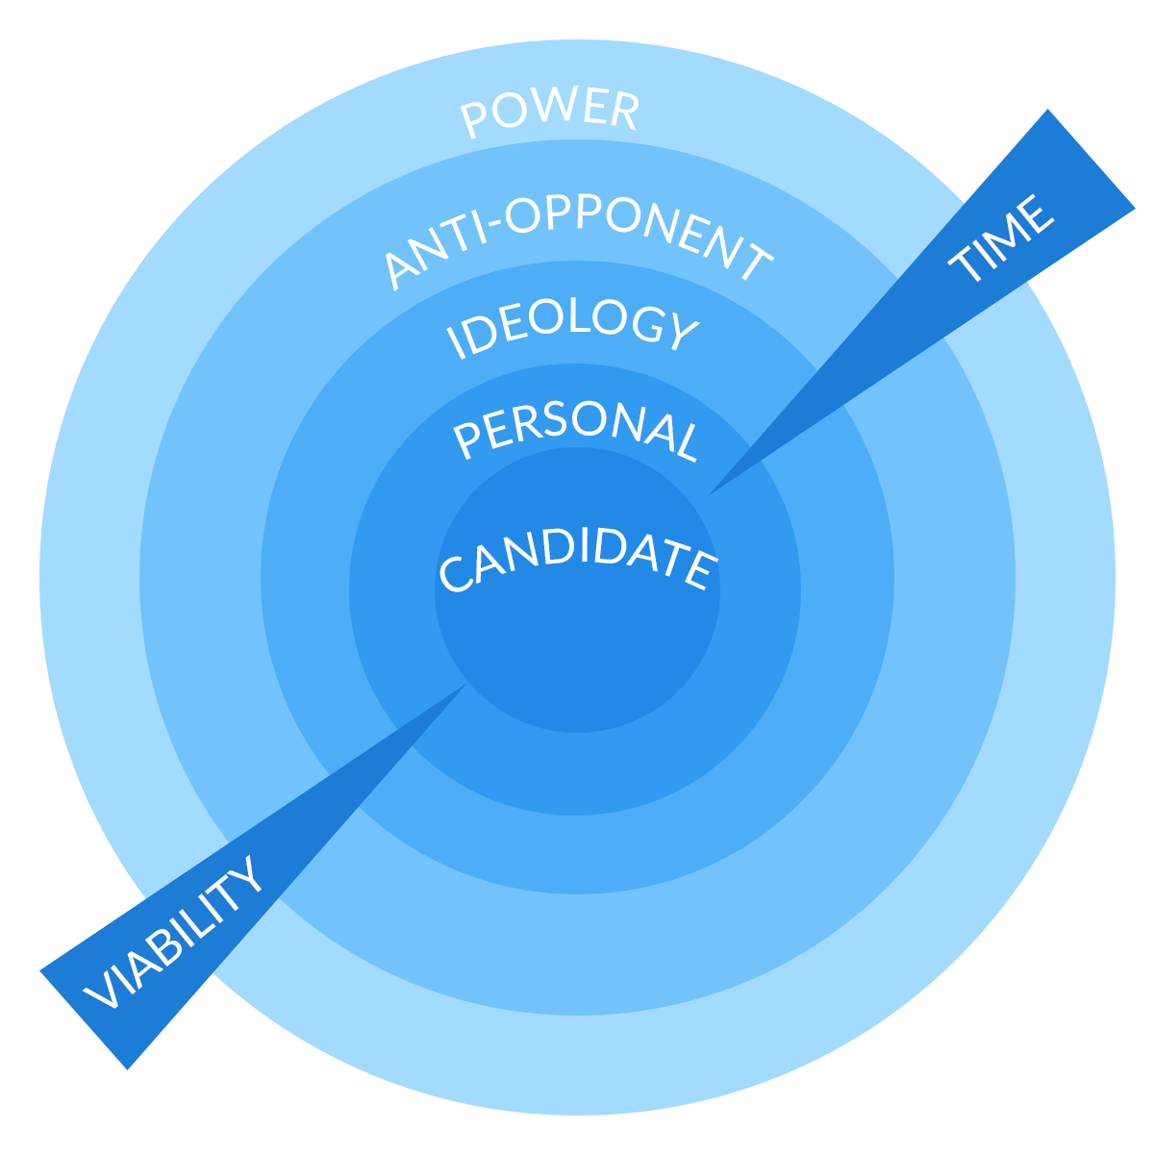
-ROLODEX yourself
-You want to focus on your concentric circles of giving
-Finally you want to cultivate your donors for not just this election but for future elections
Notes:
People WANT to give you money. You are asking for a cause, not for personal use.

Slide 7
Putting the plan together…
Messaging & Networking
Write down why you want to serve & become comfortable telling your story to others. What in your past motivates you to run? How do you want to help your community? Why is it important that voters elect you *now,* this year?
Know Your Audience! Ask your neighbors & community leaders for their perspectives on the challenges & opportunities in your town
Leverage your platform & networks. Does your local democratic committee know your running? How can friends and family help spread your message?
Tout your experience! What makes you qualified for the office you seek? Being a community member, taxpayer, mom, former public school student, etc. → All relevant!
Notes:
Story of self as a candidate (self, us, now)
What in your background makes you qualified to do this? Taxpayer, mom, relatable, etc.
Digital & Mail → Good to stick to your personal story. Maybe you know exactly what they want to do in town office; focus on top priorities (~3 or so)
Networking→ Talk to the fire chief, police chief, teachers, community leaders. Listen to their concerns, find out what issues are most important to your neighbors
Political contacts: Community stakeholders:
Make sure the chair of your town Democratic committee knows that you’re running!
Could you speak at a meeting to try and recruit volunteers or solicit donations?
Do they have an email list you could send a fundraising pitch out to?
Could they connect you with local democrats who have served or are currently serving in the position you’re seeking?

Slide 8
Putting the plan together…
Direct Voter Contact + Win Numbers
Contextualize your victory: Calculate your win number!
Avg. last 3 elections results (total voters)/2 + 1 (or + win margin desired)
Get direct voter contact lists (Mail, Phone, Walk lists) from your local Dem committee or the NHDP.
Remember that it takes 5-8 “touches” to get people to take action. Plan multiple contact points for each voter (call, canvass, mail, digital ads, etc.)
Schedule your voter contact activities and set weekly voter contact goals.
What is Direct Voter Contact? One to one, individual conversations or communication w/ voters
How: Phone calls, scheduled meetings, literature drops/canvassing, mail
Why: Voters need your attention & especially welcome conversations w/ candidates
→ Provide your background & passion → Develop trust, community, and relationships, and earn votes!
Notes:
What is your target number? Why is voter contact important?
How to access voter lists
Why you should get a list from the town clerk, and how to get it?
Who turns out for these elections? Who should you call? Encourage lit drops over canvasses, mail over lit drops.

Slide 9
Putting the plan together…
Tactics + Planning
As you develop your plan, understand the impact and resource costs of different tactics:

Slide 10
Putting the plan together…
Planning + Scheduling
Work backwards from election day. Plan week by week to ensure you meet your goals:
| Sample Weekly Plan|

Slide 11
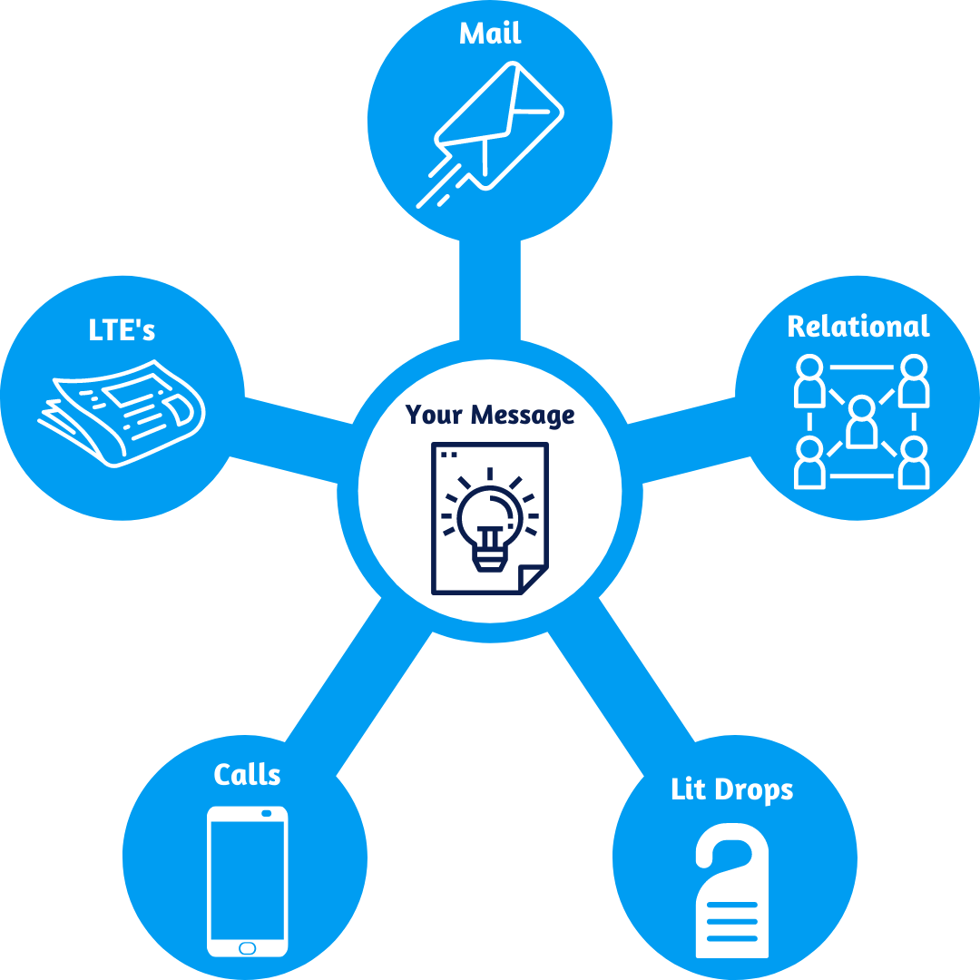
Putting the plan together…
Messaging Tactics
It takes 5-8 campaign touches to get voters to take action. You’ll need multiple tactics with consistent messaging to convince and activate voters.
Notes:
Ways to get your message out
1. Call voters & recruit volunteers to help you call voters
2. Print multi-purpose literature that you can mail to voters and drop on their doors
3. Write a letter to the editor about your candidacy to your local paper, or ask a community validator to write one on your behalf
4. Relational organize in your town: Ask every supporter you have to identify 3 friends/family members/colleagues that they will make sure turn out for you on election day. Ask them to identify their 3, and follow up with them to remind them

Slide 12
Takeaways
Time Management & Urgency Are Key
Start with your Budget & Bank
People Want to Help → But you need to ask them!
Identify and focus on likely voters
Set Goals → Set a timeline. Hold Yourself Accountable (write a plan!)
Notes:
Time management & urgency → Get your AB, bank account, do the things that need to get done NOW, now
Budget & Bank
People want to help you→ Ask for help
Talk to people who are going to vote anyways→ A mail piece sent to a Republican who will definitely vote is less of a waste than trying to convince someone to register to vote for town meeting day. Name Recognition Wins on Town Meeting Day
Set, goals hold yourself accountable, work with us! But also be realistic.

Slide 13
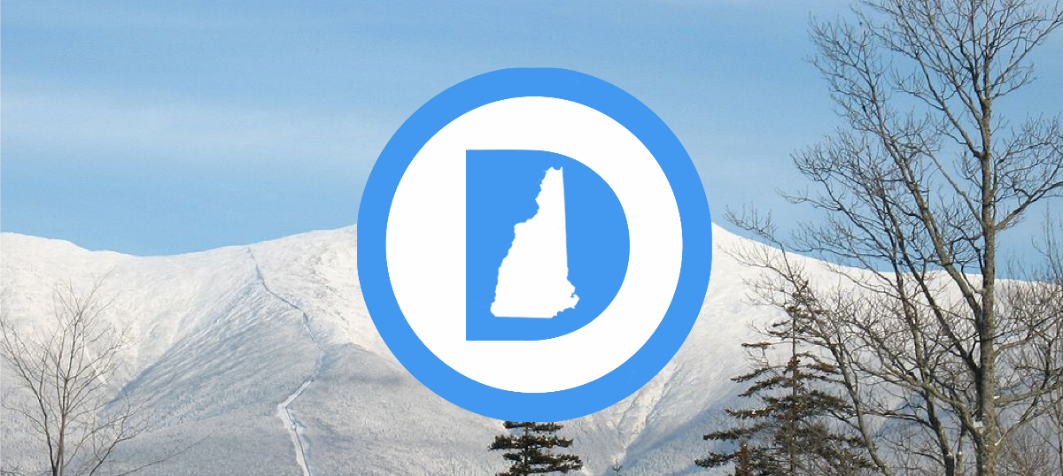
Additional Resource:
-The New Hampshire State Democratic Party
-Your local Democratic Committee
-Organized Allied interest Groups/Organized Later (Teachers, Firefighters, Sierra Club, NH Young Democrats, 603-Forward, Kent Street Coalition, Rights & Democracy, etc).
Notes:
Donnie Spencer

